Slide 1

PORTAL MAP VISUALIZATIONS TimeSeries

Slide 2
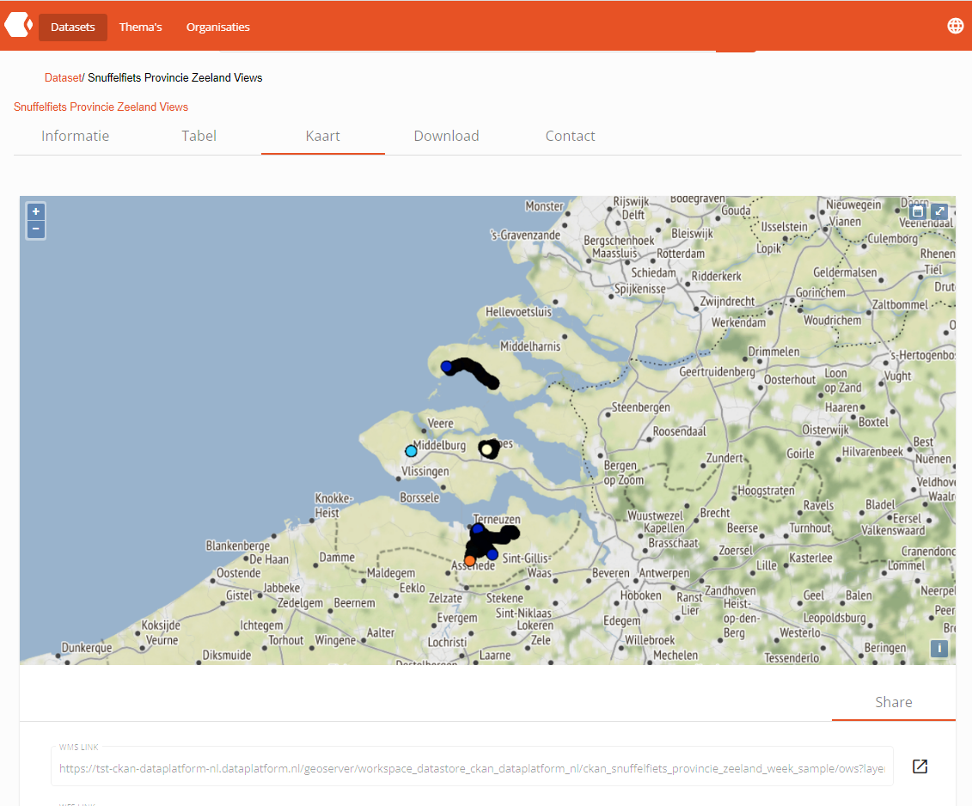
Displaying the TimeSeries Control
Loading a resource containing a timestamp metadata*, will enable the TimeSeries Control inside the Map Visualization.
This is located in the top right corner, next to the FullScreen Control
*To define timestamp metadata, a user must have access to edit the metadata of the resource (CKAN) and populate the field named “Time series column” with the exact name of the table column that contains the timestamp data.

Slide 3
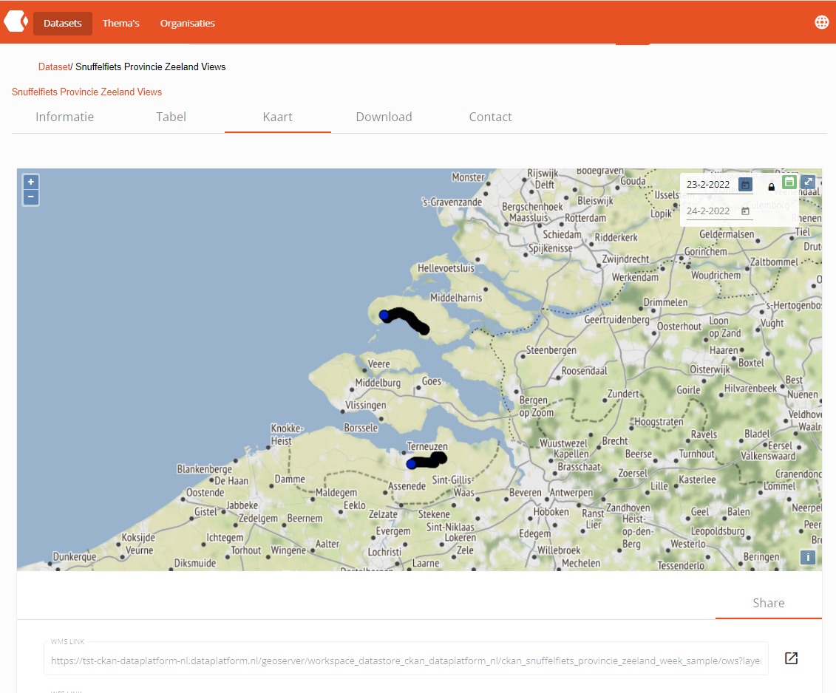
Activating the TimeSeries filter with default date range
Activating the TimeSeries filter will result in:
The TimeSeries Control will be expanded and colored green.
Map will automatically be refreshed to project data based on the current date, with a predefined date range of 1 day (00.00-23.59)
The default date will correspond to “today”.
Selecting a different date, will automatically trigger a map refresh, keeping the same date range interval.

Slide 4
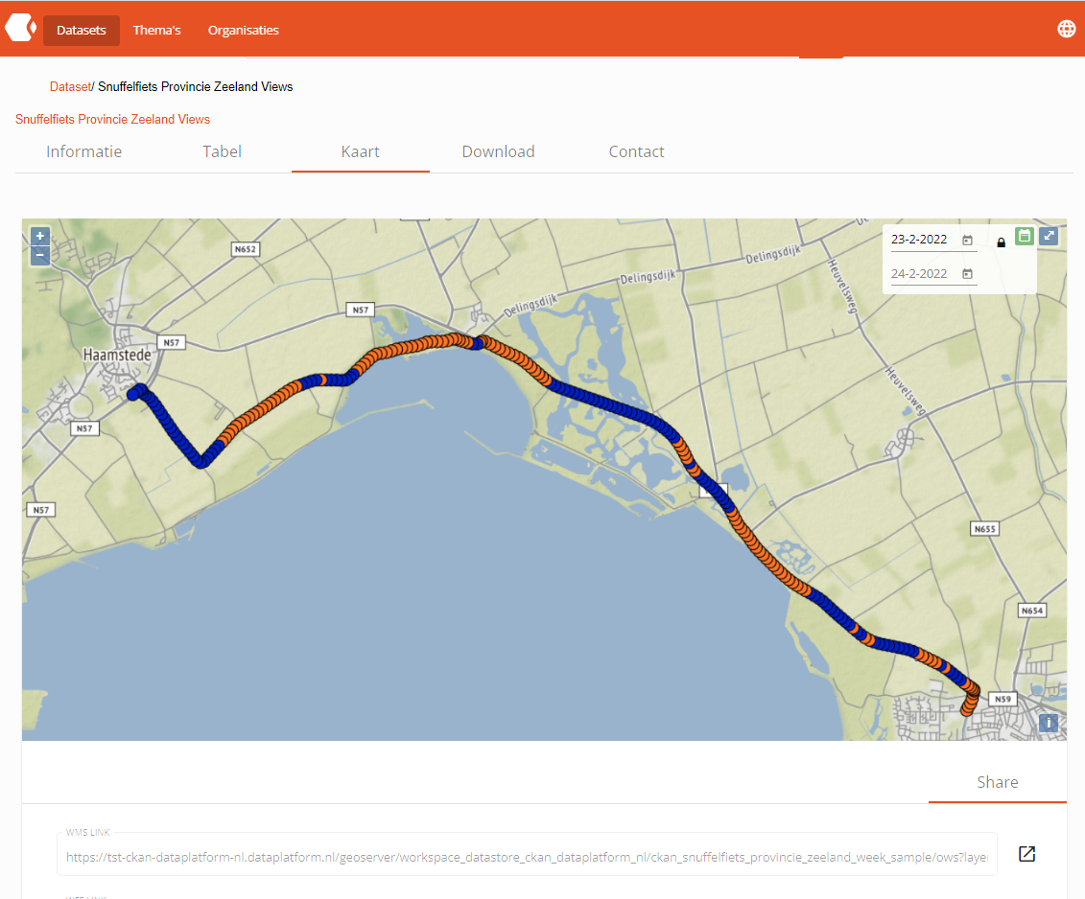
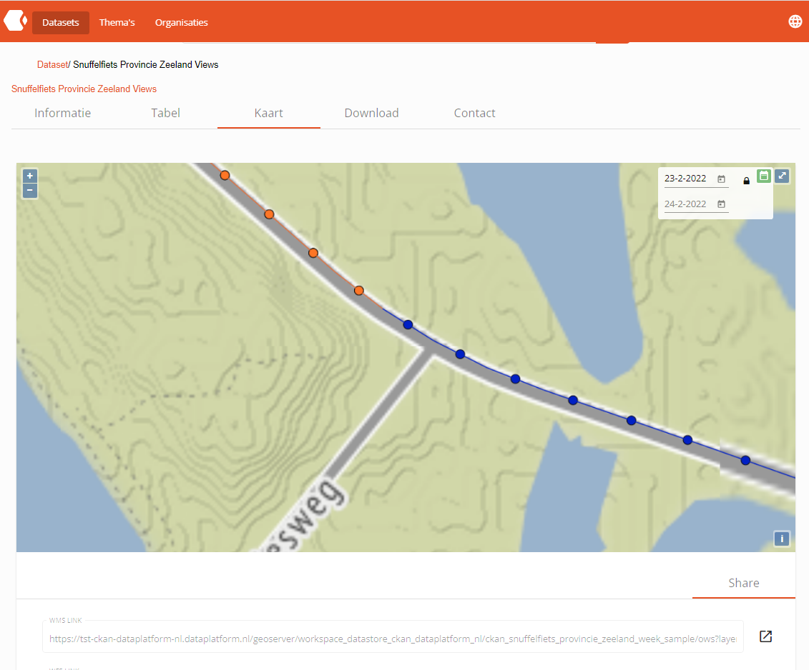
Activating the TimeSeries filter with default date range
Applying styles (SLD) in a TimeSeries data can enhance the appearance of the displayed data.

Slide 5

Enabling custom date range for the TimeSeries filter
The locker icon inside the TimeSeries Control gives the ability to control the date range set.
By unlocking the date range, the user can choose both the start and end date of the data to be displayed.

Slide 6
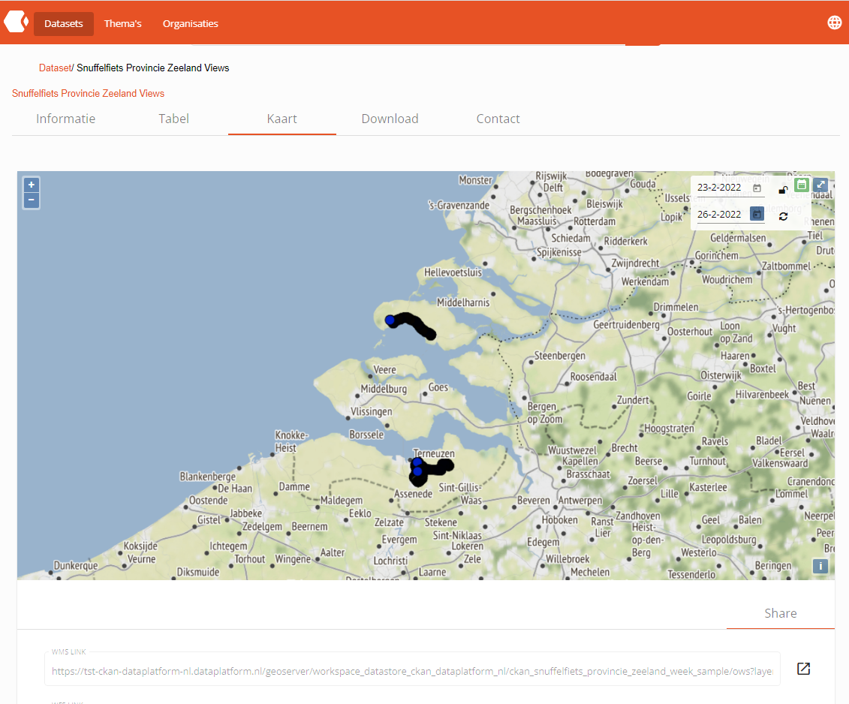

Setting custom date range for the TimeSeries filter
Setting a custom date range is a two-step process.
The user has to select the desired dates and click on the Refresh Icon.
This will manually trigger a map refresh and display the available data.

Slide 7
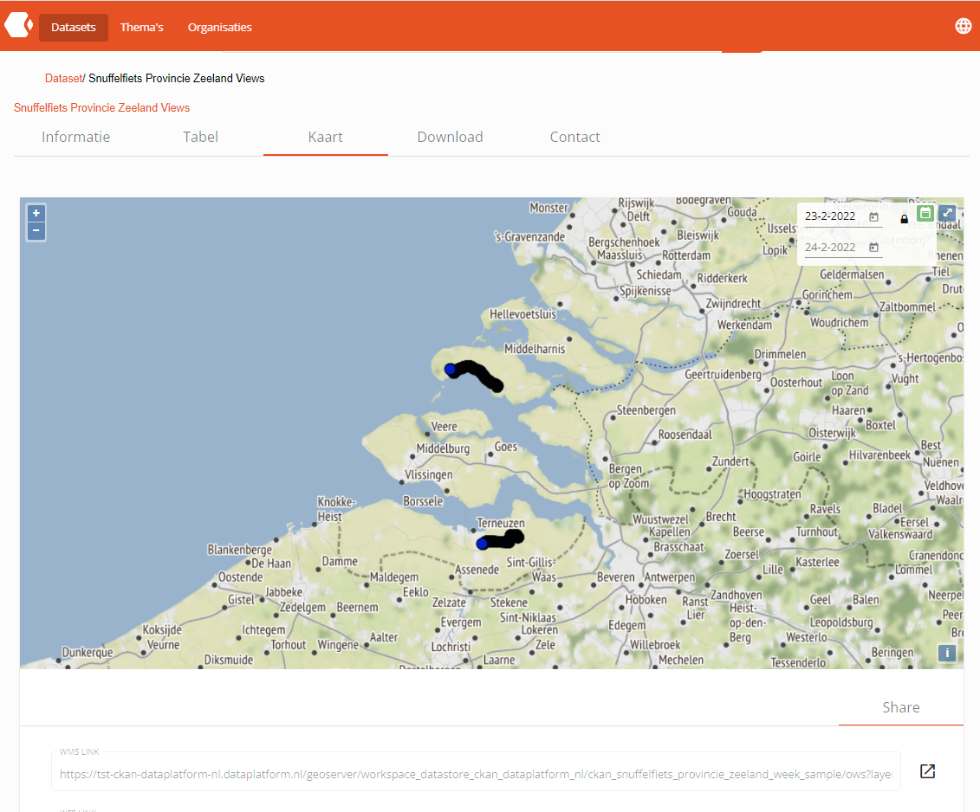
Disabling custom date range for the TimeSeries filter
If the user decides to disable the custom date range, the expected behavior will be like this:
Start date will remain the same.
End date will be automatically set to the default date interval of 1 day.
The map will be automatically refreshed to the new range.
The available data will be displayed.

Slide 8
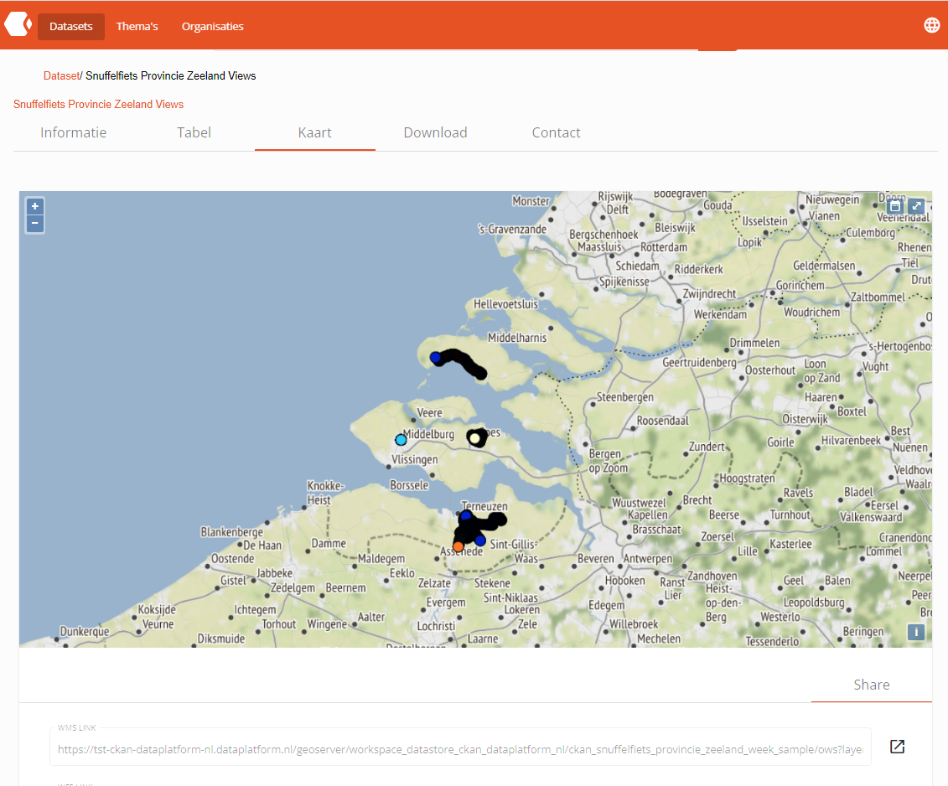
Deactivating the TimeSeries filter with default date range
If the user decides to deactivate the TimeSeries filter, the TimeSeries Control will be hidden and the map will be automatically refreshed to display the full data available in that layer.
*Based on the size of the available data,
map refresh may take several seconds to complete.

Slide 9
PORTAL MAP VISUALIZATIONS .

